Slide 1

Final Business Plan
Elise Carlsten, Charlie Miller, Maryam Raza-Ratchford
Spring Capstone 2025

Slide 2
Table of Contents
I.
II.
III.
IV.
V.
Product Details
Insights from
Survey & KOLs
Market Analysis
Business Model
Challenges, Strengths & Recommendations

Slide 3
01
Product Details

Slide 4
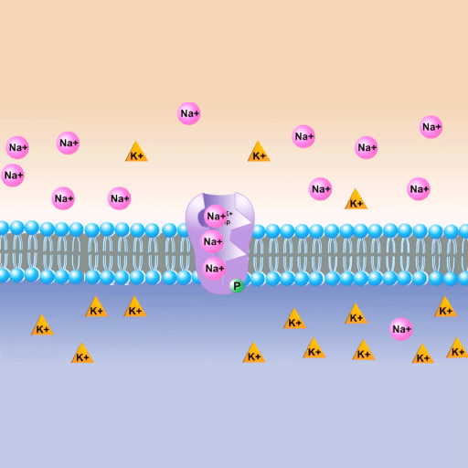
Unmet Needs
Sodium (Na) and potassium (K+) are critical health measurements for multiple chronic health conditions
Current blood metabolic lab tests produce delayed results, are costly, and increase workload for medical staff.
Imbalances quickly arise and can lead to detrimental complications
(cardiac arrest, fluid overload)

Slide 5
There is a need for a faster, reliable, and non-invasive way to measure sodium and potassium in clinical and at-home settings to track insights, adapt treatment plans, and provide timely care.

Slide 6
What is AccuNaK?
A New Diagnostic Device
Why?
A microneedle-based sensory device designed for real-time, minimally invasive monitoring of Na and K+ in the blood to improve care in both acute and chronic disease management.
For both inpatient and outpatient use, the diagnostic device offers a pain-free alternative to frequent blood draws and provides fast insights to understand patient status and improve insights, interventions, and quality of life.

Slide 7
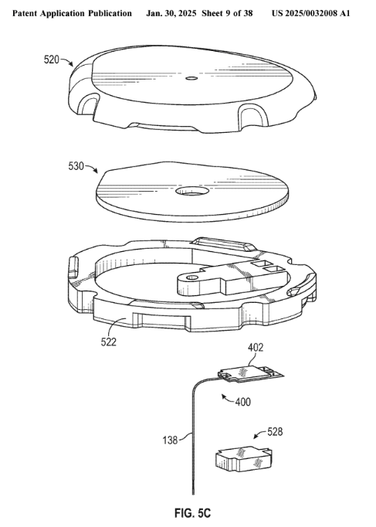
Adjust the continuous glucose monitor…
Alteration of the biosensor to acutely read Na/K+ in blood
Combine a skin-interfaced microneedle biosensor with a digital platform to display electrolyte readings:
Share data with medical providers
Track patient status
Analyze treatment impacts
Improve overall health management
Dexcom, Inc. (2025). Preconnected Analyte Sensors. (US 2025/0032008 A1). U.S. Patent and Trademark Office.

Slide 8
02
Insights from Survey
& Key Opinion Leaders

Slide 9
Survey Results
Current measurement challenges, adoption scenarios, limiting factors
 | Chronic Kidney Disease Patients | Specialists
Total Responses | 30 | 17
Valid Responses | 20 | 5
Contact Method | Social Media | Email, word of mouth
Impact of Na/K+ on health, willingness to purchase, desired features

Slide 10
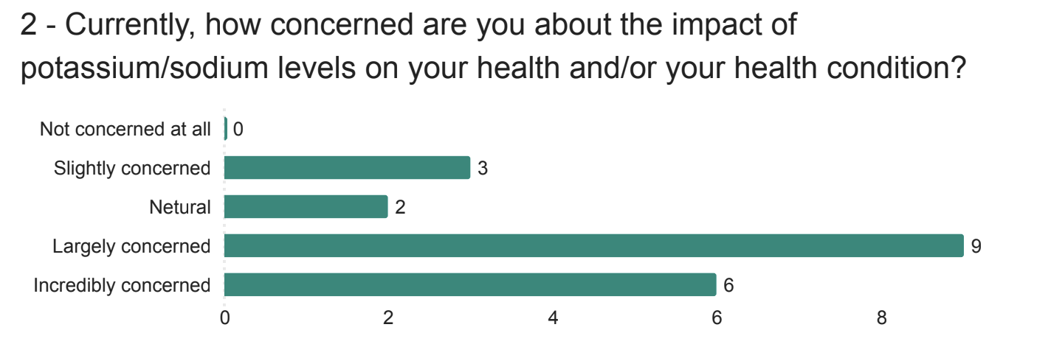
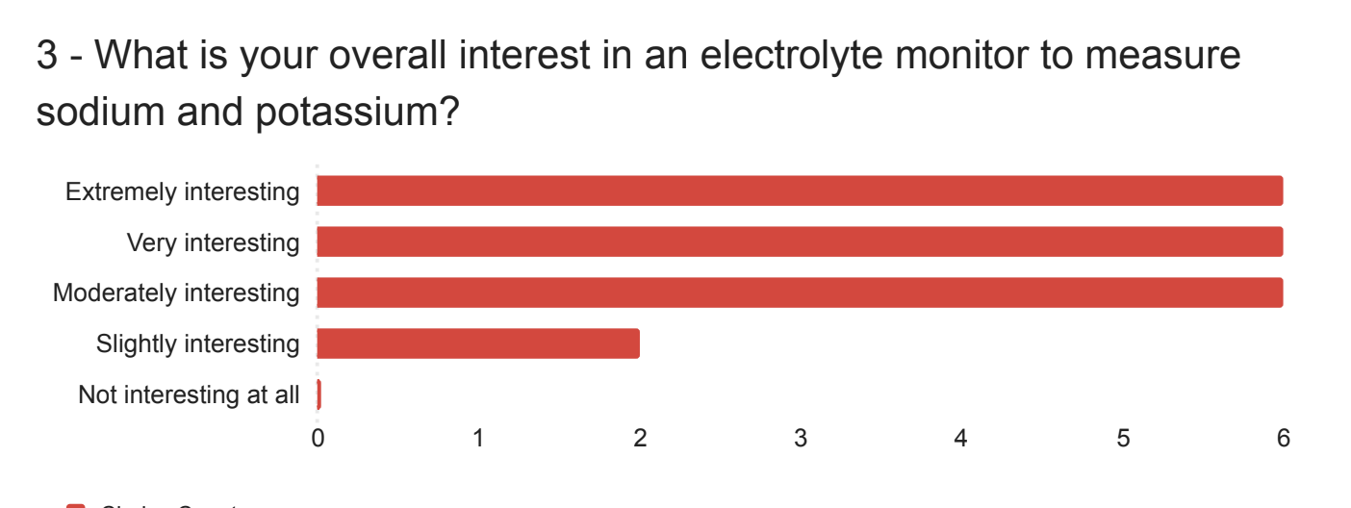
Patient Survey

Slide 11
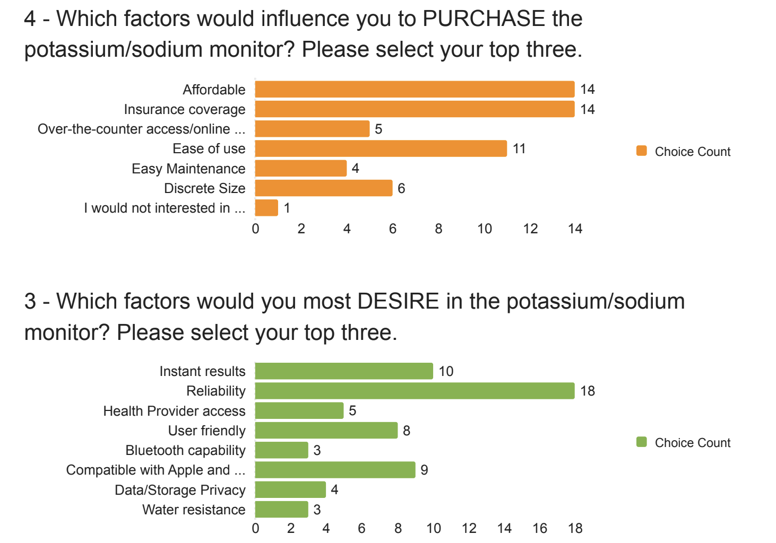
Patient Survey
14/20 learn about medical devices from doctors!

Slide 12
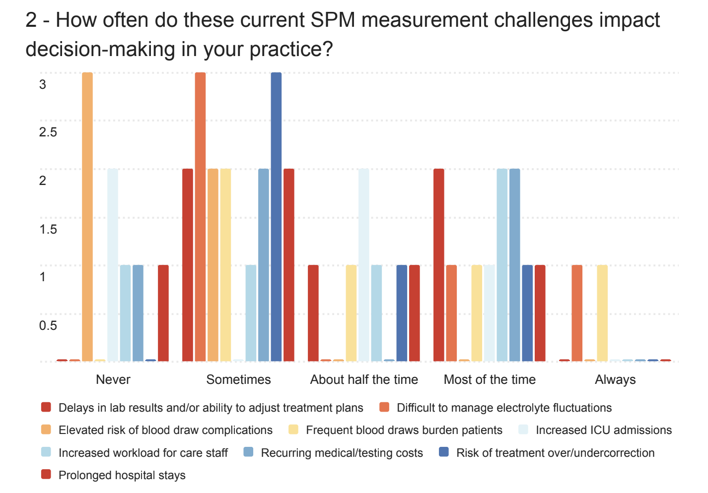
Provider Survey

Slide 13
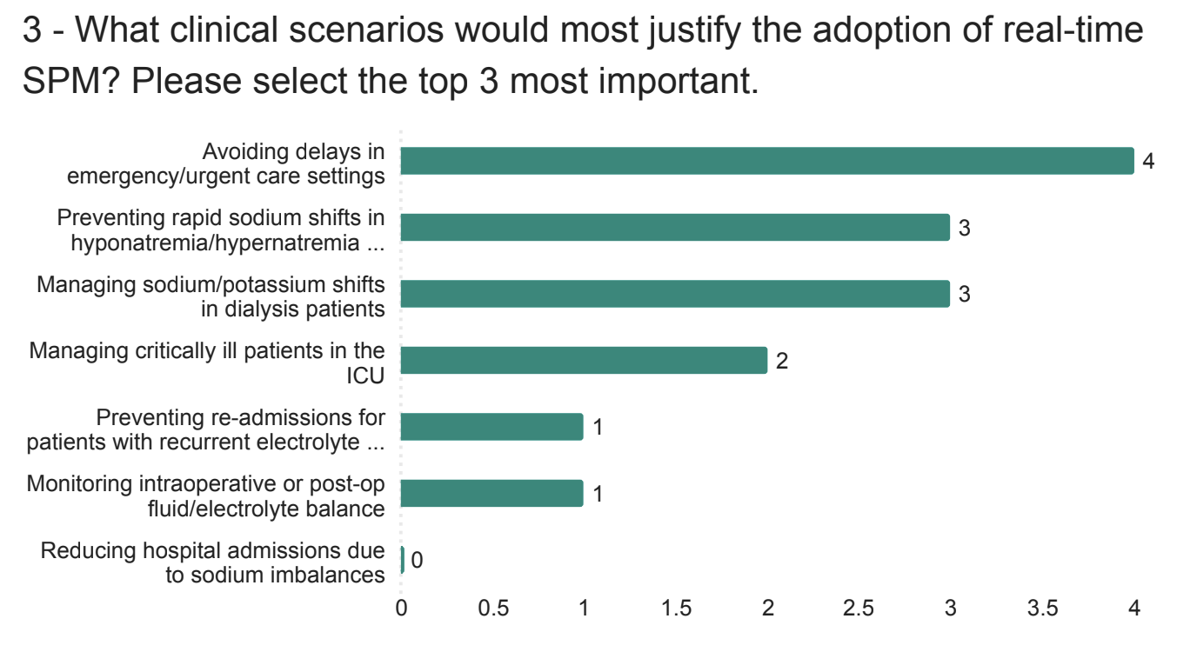
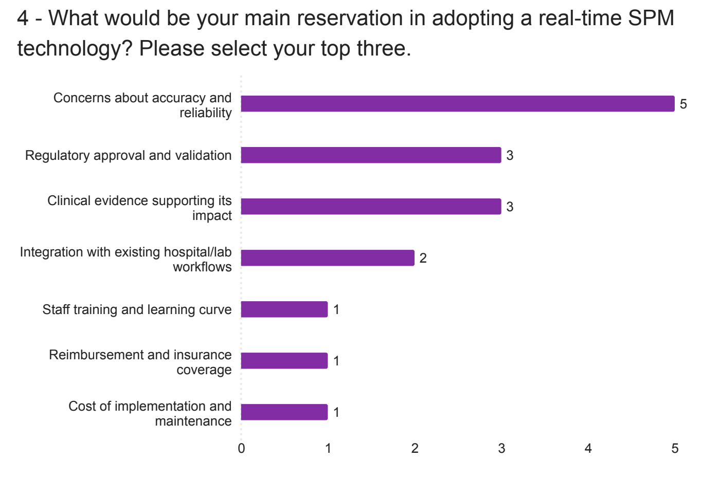
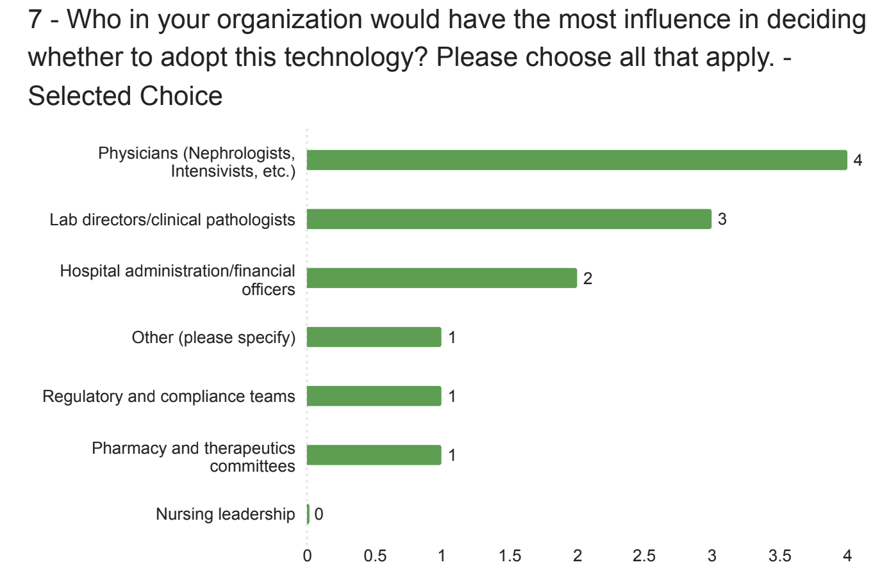
Provider Survey

Slide 14

Professor and Chair, Dept of Internal Medicine & Nephrology,
Eastern Carolina University
Dr. Paul Bolin
Applicable in High-Risk Situations
Current blood gas tests take ~5 minutes → delays are common
Critical for cardiac surgery and cardiac arrest situations ("codes")
CGM companies hold broad biomarker patents on purpose, but there is room
Emphasis on Endurance Athlete Market
Real-time tracking of hydration and electrolyte levels during exertion
Integration potential with smartwatches and wearables
Opportunities for lactate monitoring and brand partnerships (e.g., Gatorade, Hoka, Boston Marathon)

Slide 15
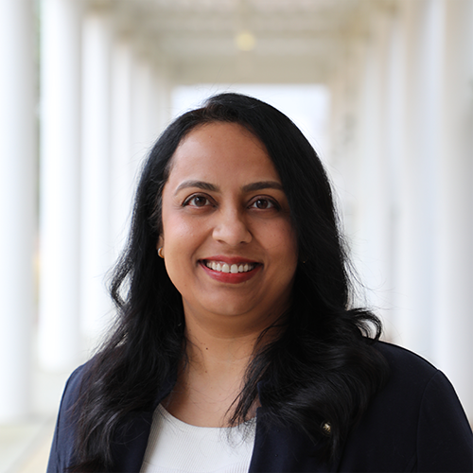
Dr. Smruti Patil
Licensing Associate
NCSU Office of Research Commercialization
IP Considerations
Secure broad provisional patent(s) to get rolling on the process now
510(k) premarket approval and a Supplemental Premarket Approval (sPMA)
  Easier approach b/c similar to currently approved products
Licensing Approach to Dexcom/Abbott
Ensure minimal disruption to the current product line
Align IP strategy closely with current business goals of larger company
  Highlight clear value + innovation proposition to strengthen IP position
Key Negotiation Advice
Begin with higher terms to allow room for negotiation
Royalties on net sales > individual sales
Stay flexible and strategic

Slide 16
03
Market Analysis

Slide 17
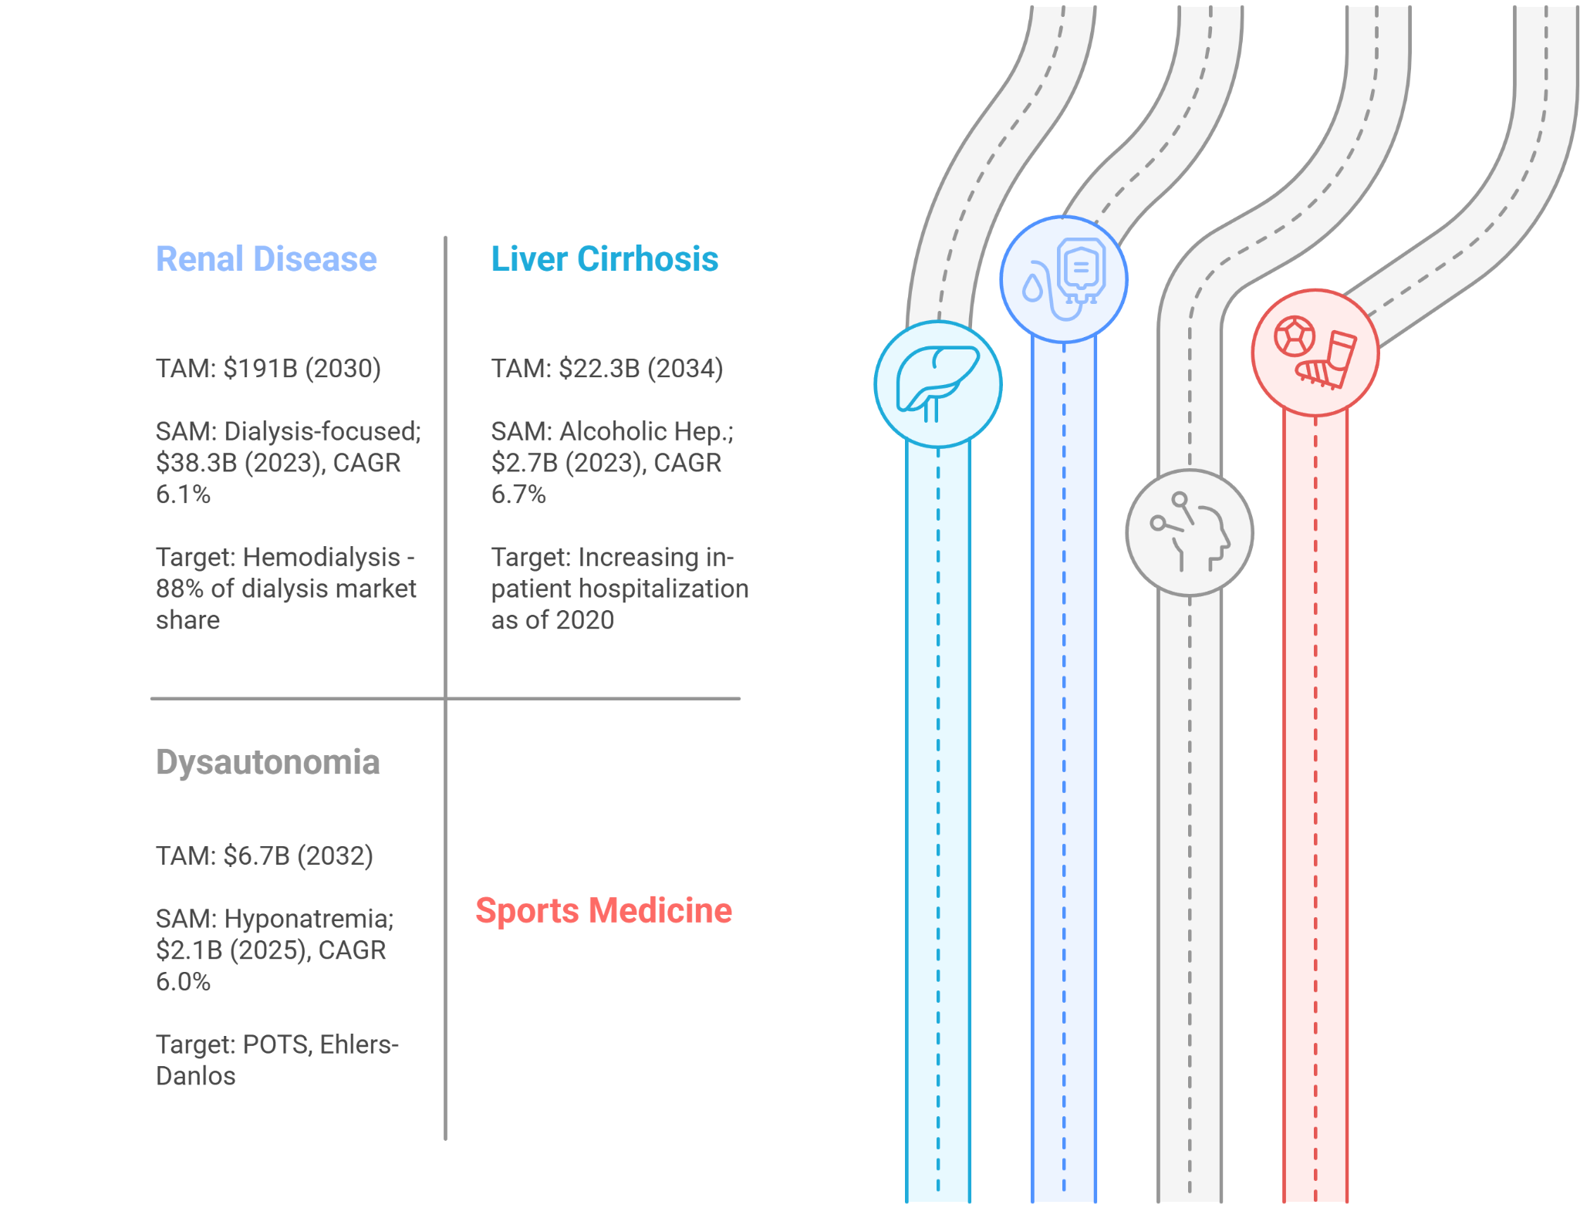
Market Size

Slide 18
Customer Segments
Cardiologists
Nephrologists
Neurologists
ER/ICU Physicians
Dialysis Centers
CGM Manufacturers
IV electrolyte therapy industry
Sports Drinks Companies
Hospital Purchasing Committees
Pharmacy & Therapeutics Committee
Insurance Providers
45+ years old
Affected by ESRD, liver disease, cardiac concerns, cancer, hyponatremia, hyperkalemia

Slide 19
Channels & Relationships
HOSPITALS & CLINICS
Educate providers, promote adoption, outreach to patients, connect with relevant committees
CONFERENCES & ROADSHOWS
Network with strategic partners, build trust and bring visibility
DIRECT-TO-CONSUMER
Build awareness and engagement with at-home users, support with educational content
ACTIVE CUSTOMER SERVICE
Maintain long-term relationships, provide continuous education through white papers
B2B OUTREACH
Establish talks with partners, discuss licensing, develop cost-savings, align incentives

Slide 20










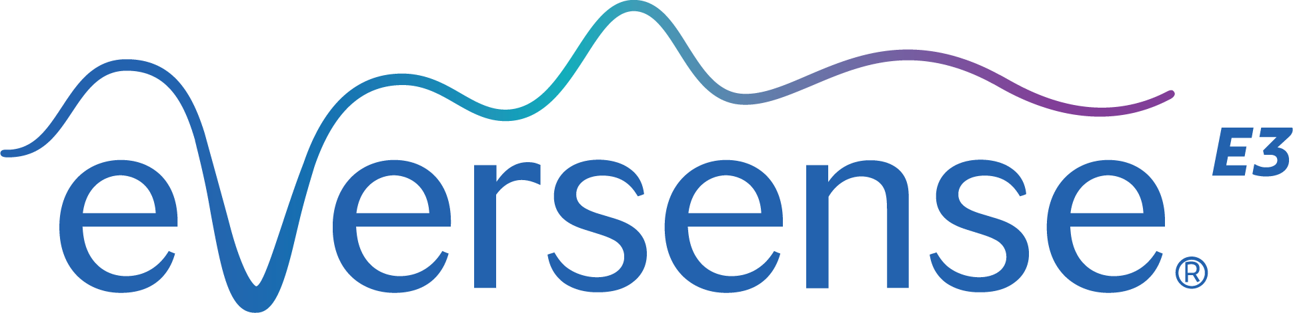
Competitors
Traditional Blood Tests
Point-of-Care

Slide 21
04
Business Model

Slide 22
Key Activities
Refine Core Technology
Validate Against Gold Standards
File and Strengthen IP
Negotiate Licensing & Partnerships
Initiate Clinical Trials
Pursue Regulatory Approval
Leverage Strategic Commercialization
Drive Provider and Patient Education

Slide 23
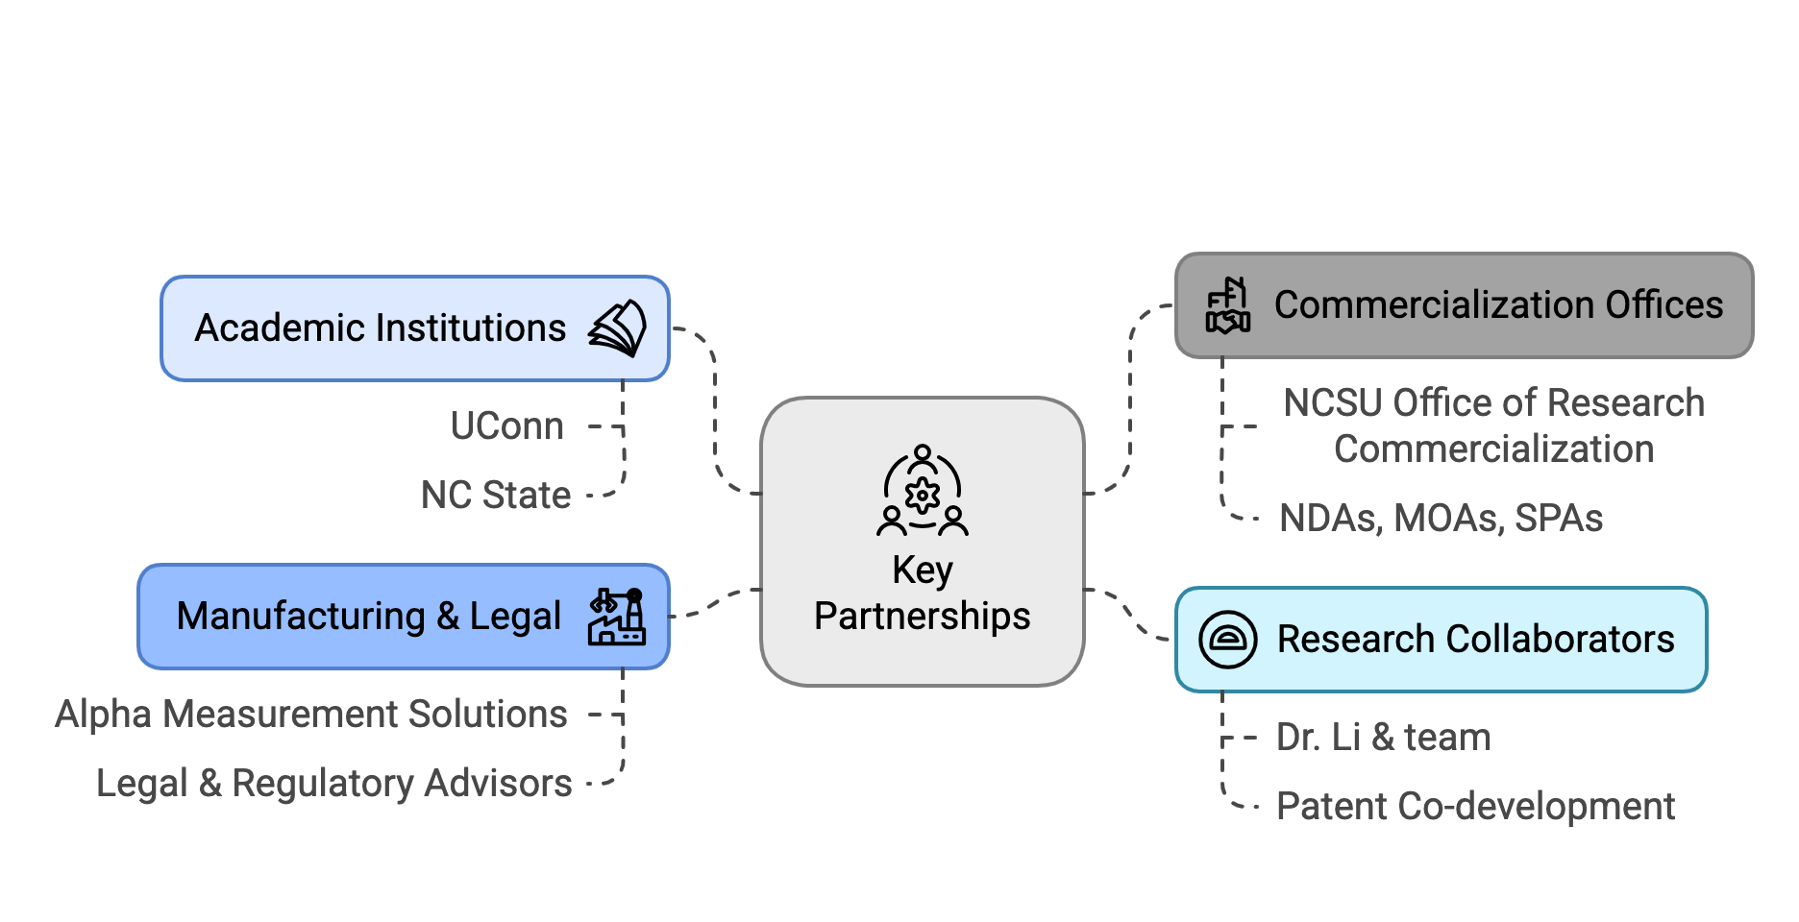
Key Partnerships

Slide 24
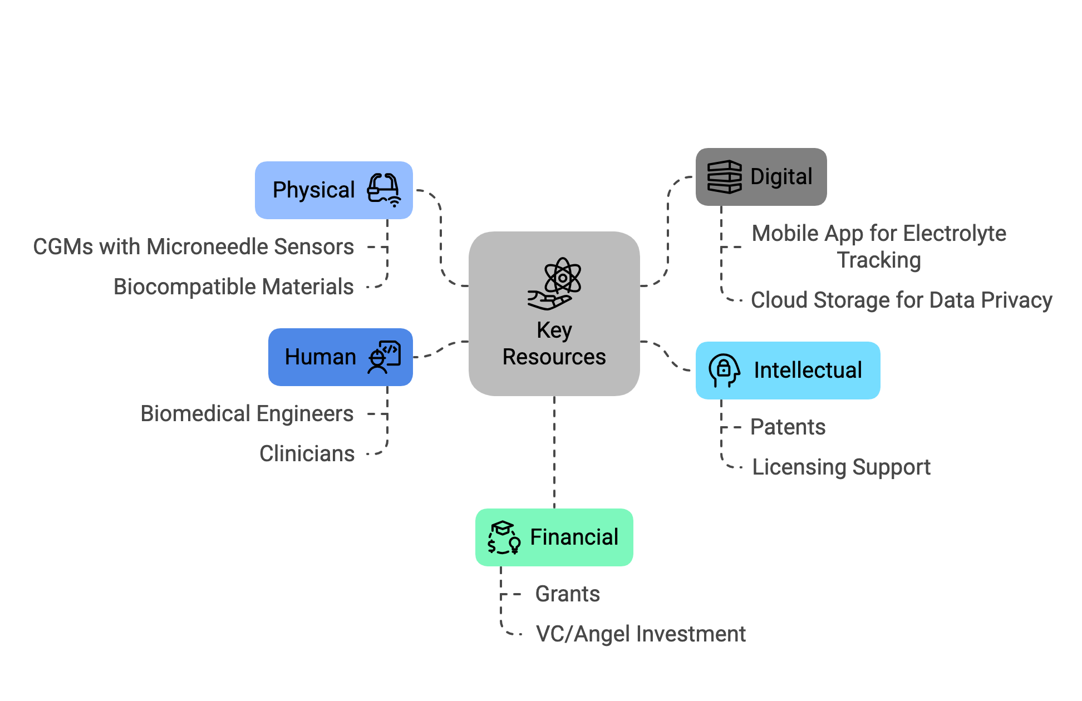
Key Resources

Slide 25
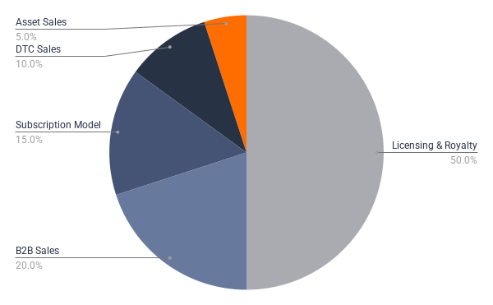
Possible Revenue Streams
50%
20%
15%
10%
5%
Licensing & Royalty
B2B Sales w/ Hospitals & Healthcare Systems
Subscription Model
Direct To Consumer
Asset Sales or Acquisition

Slide 26
COST BREAKDOWN
Cost Item
Estimated Cost
Device
Development
Sensor Fabrication
$54-$300 per unit
Transmitter Development
$200-$600 per unit
Software/App Development
$25,000-$100,000
Biocompatibility Testing
$5,000-$20,000
Intellectual Property
US Utility Patent Filing
$15,000-$25,000
International PCT Filing
$50,000-$100,000
Maintenance & Legal Counsel
$10,000-$20,000
Exclusivity Rights Strategy
$5,000-$15,000
Clinical &
Regulatory
Clinical Trial (Phase I/II)
$250,000-$1M+
FDA Submission (510(K)/PMA)
$50,000-$150,000
Preclinical Studies
$25,000-$75,000
Post-Market Surveillance Setup
$50,000+
Licensing &
Commercial
Licensing Legal & Consulting
$10,000-$30,000
Market Access Consulting
$15,000-$50,000
Royalty Agreements
4-8% of sales
Pitch & Proposal Development
$5,000-$15,000

Slide 27
Key Partners | Key Activities | Value Propositions | Customer Relationships | Customer Segments
- CGM Manufacturers: Dexcom, Abbott - ICU/Inpatient Care: Specialists in nephrology, cardiology, etc. - Dialysis Centers: Medtronic, DaVita, Fresenius, Baxter - Research Collaborations: R+D growth, UConn - Regulatory Agencies: FDA, EMA, IRB | - Develop technical team - Refine/publish final R&D - IP & Licensing with collaborators - Clinical validation and regulatory input - Commercial production, marketing, distribution | - Optimize Care: provide fast, accurate data for inpatient care settings - Outpatient Autonomy: timely results to adjust prescriptions, monitor progress, understand alterations - Health Economics: lower costs, improve patient care management, disease tracking - Improve Health: reduce mortality rates and improve care for improper Na/K+ management | - Inpatient care training/integration - Provider-Patient trust - Data integration support - Licensing/Exclusivity | - Healthcare Providers: kidney care, cardiology - Device Diagnostics - Healthcare Systems + Payers: hospitals, insurance - Athletics: sports medicine, endurance, athletes, collaborations - Data Management: McKesson, IQVIA, Oracle
 | Key Resources |  | Channels
 | - Hardware/software development - IP/Licensing consulting - Manufacturing & Capital Partners |  | - Healthcare providers & networks - Inpatient Care - Direct-to-Consumer - Payer partnerships - Clinical studies
Cost Structure |  | Revenue Streams
R&D Investment: Clinical trials, tech dev. Sensor Production: $54–$300/unit, 10–14 days Transmitter Cost: $200–$600, 3–12 months | Receiver/App Cost: $70–$800, 1–3 years Annual User Cost: $1,627–$9,200 Legal Agreements: ~15% F&A, $25K–$50K | Licensing Deals: Sensor/software rights Royalties: 4–5% net sales Industry Partners: Dexcom/Abbott potential | Direct Hospital Sales: Procurement contracts Provider Adoption: Cost-effectiveness focus Prescription Access: Through healthcare systems | Fixed Pricing Model: Streamlined purchasing Direct-to-Consumer (DTC): Outpatient/personal use Subscription Model: 10–14 day cycles

Slide 28
05
Challenges, Strengths, & Next Steps

Slide 29
Challenges & Mitigation Strategies
Measurement/ Accuracy Concerns
Provider
Adoption Hesitation
Patient Misuse
Validate against venous BMP/CMP labs + conduct clinical correlation studies
Engage with early adopters (nephrologists, emergency physicians) to establish reputation
Emphasize user education, include built-in education tools and provider oversight in the app
Regulatory Complexity
Investment & Licensing Hurdles
Map FDA pathway early (510k, sPMA); involve regulatory consultants
Demonstrate cost savings overtime and unmet need; pursue strategic licensing deals

Slide 30
Strengths
Better Patient/Provider Decision Making
Addresses a Critical Clinical Gap
Enables real-time sodium and potassium monitoring as a complement to metabolic blood panels
Instant data provides current biomarker status, tracks changes over time, enables faster decision making for treatment
Improve Delays in Care
Strong Market Application & IP
Faster turnaround for Na/K+ results during critical moments while waiting for lab results
Nephrology, emergency medicine, cardiology, sports medicine, and outpatient care

Slide 31
Next Steps
Refine R&D + Pitch to Investors
Conduct in-depth patient interviews to refine value prop
Collaborate to refine the sensing technology
Pitch opportunistic time with funding landscape ($)
Intellectual Property & Ownership
Secure strong patent protection
Balance selling the concept with retaining ownership/control
Leverage NC State’s Tech Transfer Office
Negotiation with Stakeholders
Start with higher terms but
avoid overreaching
Leverage IP’s value and “know-how”
Licensing Strategy
License to established CGM/device companies vs. building solo
Highlight value added with ease of integration
Emphasize minimal disruption to current products
Market Strategy
Smaller, high-need markets will
prove concept
Expand market use cases with time

Slide 32
Thank you, MMB!
Dr. Sue Carson, Ms. Meaghan Knappo, and our fellow classmates - thank you!

Slide 33
Key Partners | Key Activities | Value Propositions | Customer Relationships | Customer Segments
- CGM Manufacturers: Dexcom, Abbott - ICU/Inpatient Care: Specialists in nephrology, cardiology, etc. - Dialysis Centers: Medtronic, DaVita, Fresenius, Baxter - Research Collaborations: R+D growth, UConn - Regulatory Agencies: FDA, EMA, IRB | - Develop technical team - Refine/publish final R&D - IP & Licensing with collaborators - Clinical validation and regulatory input - Commercial production, marketing, distribution | - Optimize Care: provide fast, accurate data for inpatient care settings - Outpatient Autonomy: timely results to adjust prescriptions, monitor progress, understand alterations - Health Economics: lower costs, improve patient care management, disease tracking - Improve Health: reduce mortality rates and improve care for improper Na/K+ management | - Inpatient care training/integration - Provider-Patient trust - Data integration support - Licensing/Exclusivity | - Healthcare Providers: kidney care, cardiology - Device Diagnostics - Healthcare Systems + Payers: hospitals, insurance - Athletics: sports medicine, endurance, athletes, collaborations - Data Management: McKesson, IQVIA, Oracle
 | Key Resources |  | Channels
 | - Hardware/software development - IP/Licensing consulting - Manufacturing & Capital Partners |  | - Healthcare providers & networks - Inpatient Care - Direct-to-Consumer - Payer partnerships - Clinical studies
Cost Structure |  | Revenue Streams
R&D Investment: Clinical trials, tech dev. Sensor Production: $54–$300/unit, 10–14 days Transmitter Cost: $200–$600, 3–12 months | Receiver/App Cost: $70–$800, 1–3 years Annual User Cost: $1,627–$9,200 Legal Agreements: ~15% F&A, $25K–$50K | Licensing Deals: Sensor/software rights Royalties: 4–5% net sales Industry Partners: Dexcom/Abbott potential | Direct Hospital Sales: Procurement contracts Provider Adoption: Cost-effectiveness focus Prescription Access: Through healthcare systems | Fixed Pricing Model: Streamlined purchasing Direct-to-Consumer (DTC): Outpatient/personal use Subscription Model: 10–14 day cycles

Slide 34
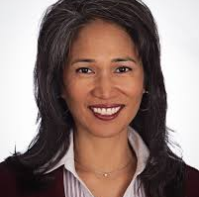
Dr. Barbara S. Gillespie
MD, MMS, FASN
VP at Fortrea
Key Considerations
Sodium offers limited value and carries interpretation risks for patients
Potassium is critical—especially for dialysis patients—due to cardiac risk
Accurate potassium monitoring could prevent life-threatening hyperkalemia
Electrolyte Measurement Methods
Blood draw is the clinical gold standard
ISF readings face skepticism due to fluid compartment shifts
ISF less accurate but offers real-time, non-invasive potential
Patient Interaction Risks
Patients may misuse data or skip necessary treatments
Real-time readings could cause confusion or anxiety
Strong patient education is essential to avoid harm

