Slide 1
AccuNaK
Real-Time Insights, Better Outcomes
Maryam Raza-Ratchford, Charlie Miller, Elise Carlsten
March 18th, 2025
MB 589 - Spring

Slide 2
Table of Contents
1
Technology Overview
4
KOL & VOC Feedback
2
Value Proposition
5
Business Model
3
Commercial Strategy

Slide 3
Technology Overview

Slide 4
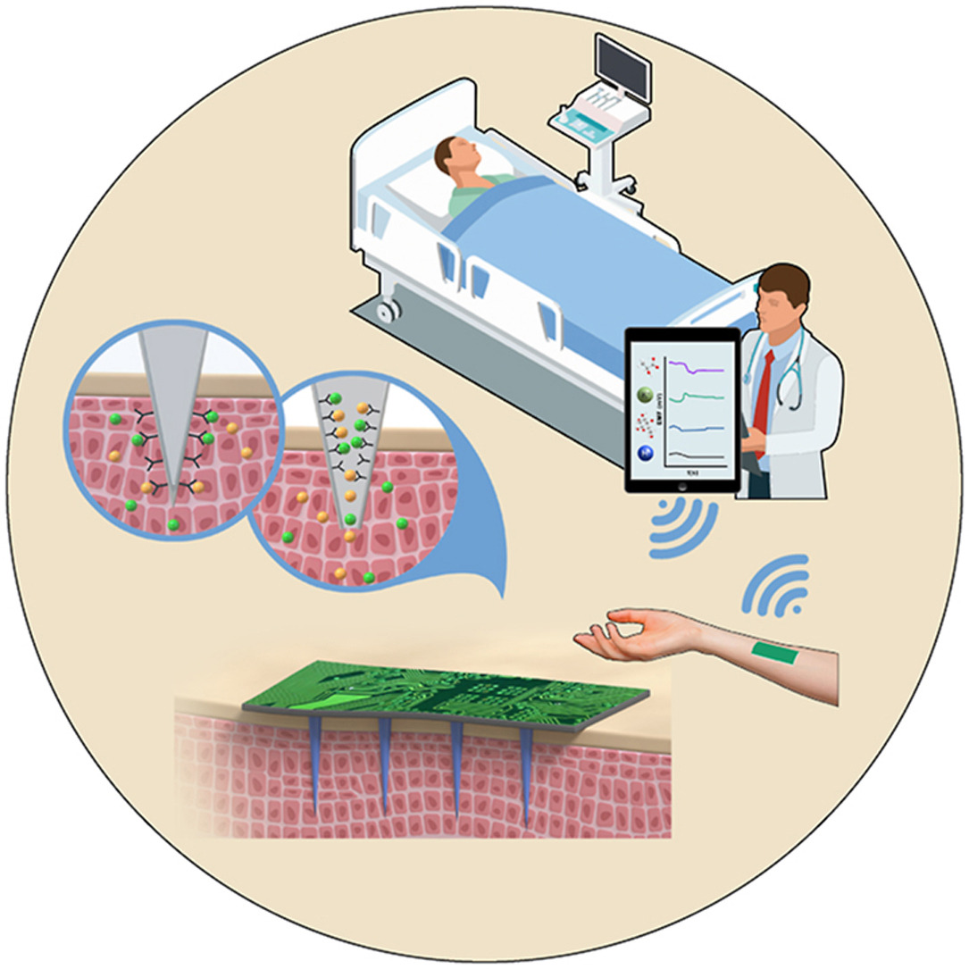
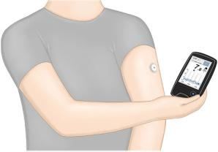
Sodium/Potassium Sensor
Product
A minimally-invasive microneedle sensor capable of measuring sodium and/or potassium to provide real-time, instant data for providers and patients.
Garcia-Guzman et al. 2020

Slide 5
Value Proposition

Slide 6
Value Proposition
Unmet Need
Pain Fixed
Gain Provided
Real-time monitoring of sodium and/or potassium is needed in many clinical settings
Current methods are hindered by high costs, delayed results, and staffing limitations
Improve patient comfort and care by reducing blood draws to give timely results
Improve health economics for both patient and provider
Cost savings
Faster/more responsive treatment adjustments
Improved management of critical electrolyte imbalances in both outpatient + inpatient settings

Slide 7
Customer Segments
Segments
Channels
Key Patient Groups:
*Liver disease (cirrhotics, cancer, alcoholic hepatitis)
*Heart failure patients
*Patients with hyperkalemia (high potassium)/ hyponatremia (low sodium)
*Dialysis patients
*Chronic Kidney Disease (CKD)
Patients with SIADH (Syndrome of Inappropriate ADH)
Dysautonomia patients
Cancer patients (chemo patients)
Key Providers Groups:
Specialists (cardiology, nephrology, neurology)
Emergency physicians
Hospital purchasing and Pharmacy & Therapeutics committees
Settings:
Inpatient Care: Emphasis on nephrology and emergency care
Outpatient Care: At-home continuous monitoring for patient self-management/information
Clinical Demonstrations: Case studies to drive provider interest and adoption
Conferences/Manufacturer Collaborations: Trusted name-brand devices would help promote adoption
Marketing Approaches:
General electrolyte monitor - broad applications across multiple patient groups
Tailored to cohorts (kidney/heart disease)
Notes:
Market Research and Feedback
Surveys/feedback from patients and inpatient specialists to gauge utility and impact on clinical decisions
Ex. Could device reduce ICU transfers and improve decision making in real-world hospital settings?

Slide 8
Customer Relationships
Customer Adoption
How?
Direct relationships with specialists and emergency physicians to demonstrate clinical value and health economics benefits (e.g., reduced ICU stays)
Hospital purchasing committees to drive adoption at the institutional level
Patient awareness based on co-creation from provider
Emphasize Health Economic Benefits
Technology reduces ICU stays, relieves staff, improves clinical outcomes
Utilize Market Research + Feedback
Surveys/feedback from patients and inpatient specialists to gauge utility and impact on clinical decisions
Built on personal assistance, communities, and co-creation.
Notes:
Charlie - 1-8

Slide 9
Commercial Strategy

Slide 10
Market Size (USA)
TAM
Renal Disease - $198.1B (2030), CAGR 8.3%
Liver Cirrhosis - $22.3B (2034), CAGR 10.9%
Dysautonomia - $6.7B (2032), CAGR 10.3%
SAM
Dialysis - $38.3B (2023), CAGR 6.1%
Alcoholic Hepatitis - $2.7B (2023), CAGR 6.7%
Hyponatremia - $2.1B (2025), CAGR 6.0%
Target
Hemodialysis - 88% of overall dialysis market share
In-patient hospitalization - ↗0.49% in 2020
POTS, Ehlers-Danlos, Psoriasis

Slide 11
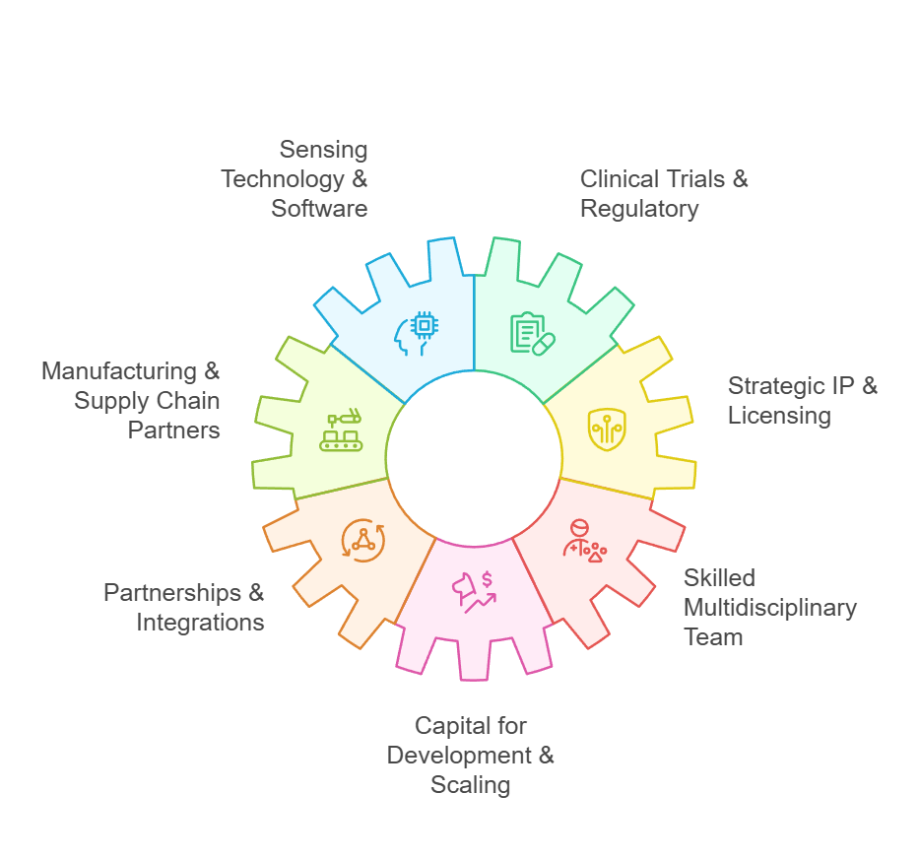
Key Resources
Major needs met through collaboration with Dexcom and/or Abbott
R&D leads in academia (such as Dr. Huijie Li, UConn)
Hardware parts for ion selective electrodes supplied by resources such as AlpHa Measurement Solutions

Slide 12
Activities/Partnerships
Preliminary Activities
Commercial Activities + Partnerships
Develop a subject matter expert team: biomedical/electrical engineers, software developers, data/clinical/material scientists
Technology Development: sensor hardware, software integration, prototype, data security
IP & Licensing: connect with current CGM manufacturers for entry into design and biomarker spaces
Clinical Validation: demonstrate accuracy, reliability, and biocompatibility through in vitro and animal studies
Manufacturing: pilot batches, scale production, quality control/assurance, distribution logistics
Commercialization: go-to-market strategies, marketing, pricing models, post-market surveillance
Partnerships: health system integration, insurance negotiations, pharmacy benefit manager, regulatory (IRB/FDA/EMA), partner for interoperability capabilities for other wearables

Slide 13
Revenue Stream
Usage fee
Licensing
Asset sale
Subscription fee
Lending/Renting/Leasing

Slide 14
Revenue Stream
Fixed Pricing Model
Provider Prescription / Insurance
Collaborative Competitor
Recurring Sale / Subscription
Direct-to-Customer (DTC)
Co-Opetition & Strategic Partnerships
Licensing
Asset sale

Slide 15
Competitors | Sweat-Based
Collaborators | Minimally Invasive

Slide 16
KOL & VOC Feedback

Slide 17
KOL Overview
Category | Contacted | Heard From
Specialists | 38 | 10
Academia | 18 | 2
Total | 56 | 12
We will have 11 completed KOL interviews by March 25th! 🎊
Notes:
@charlie

Slide 18
Dr. Blaithin McMahon
MB, BCh, PHD, Nephrologist,
Medical University of South Carolina
Renal Replacement ICU
Limitations of Current Monitoring:
ICU placement is often necessary solely for monitoring capabilities
High cost ($5,000-$6,000 per night for ICU bed)
Staffing limitations on regular floors (nurses cannot perform frequent checks)
Technical Challenges:
Must correlate with and validate against with standard venous blood tests (BMP/CMP)
Interstitial fluid measurements may not be clinically useful
*Adoption Strategy:
Focus on provider adoption rather than patient demand (nephrologists and emergency physicians)
Demonstrate health economic benefits (reduced ICU stays, better outcomes)
Work through hospital purchasing and P&T committees
Notes:
P+T is pharmacy and therapeutics

Slide 19
Dr. Emily Chang
MD, Associate Professor
UNC School of Medicine
Chronic Kidney Patient Care
Direct Quote:
“Estimates that approximately 10% of patients might experience significant electrolyte fluctuations, particularly outside of dialysis sessions when electrolytes are not being actively managed”
Current Monitoring Practices
Labs are typically checked monthly for dialysis patients
More frequent monitoring for unstable patients
Current limitation: readings at the beginning of the month may not reflect levels later in the month
Marketing Strategy:
Should be positioned as an electrolyte monitor rather than specifically for kidney or heart disease
Could benefit multiple patient populations with electrolyte concerns
Consider both patient-focused and physician-focused approaches
Notes:
@charlie

Slide 20
Dr. Huijie Li
PhD Student at University of Connecticut
Doctor of Engineering
Current Technology Principles (2021)
The sensor targets interstitial fluid (ISF) rather than blood
Uses ion-selective electrodes with specialized membranes to detect specific electrolytes
In vivo testing in poultry for accuracy
Current Challenges and Improvements
Biocompatibility issues with copper wire components; anti-folding properties
Prioritizing insertion shelf-life for at least two weeks
Future Plans and Considerations
Applying for patents through the University of Connecticut
Hoping to attract company interest for potential commercialization and partnerships → ding ding!
Notes:
@charlie

Slide 21
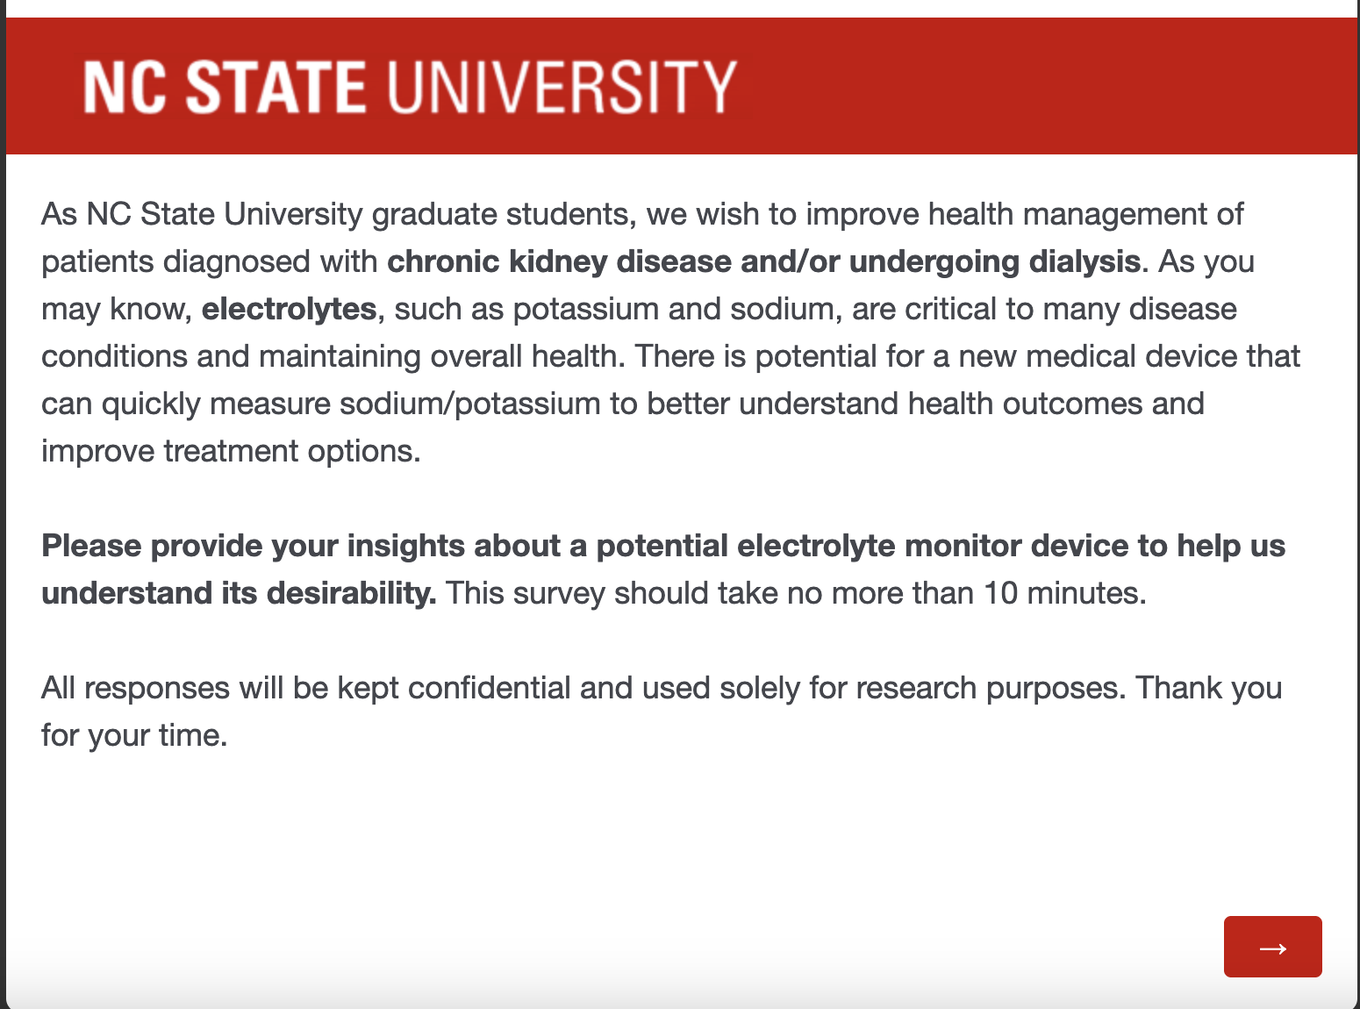
VOC Survey #1: User-Targeted Survey
Research Questions:
What are current perceptions on how Na/K affects health conditions?
Would people be willing to use an electrolyte monitor?
What are the limiting factors to purchasing this device?
Other thoughts?
Demographics
*We have one survey specific for CKD/dialysis and one for dysautonomia
Notes:
elise

Slide 22
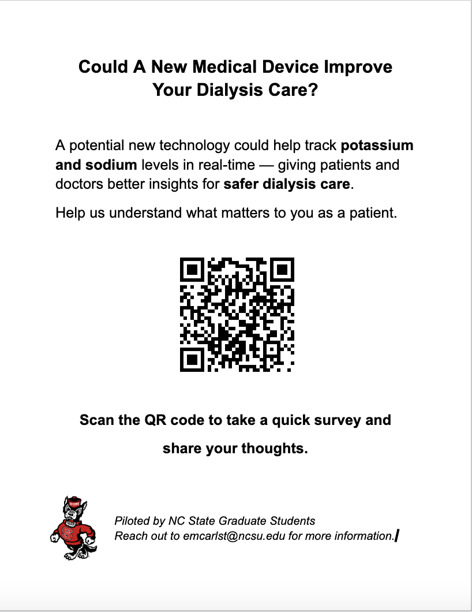
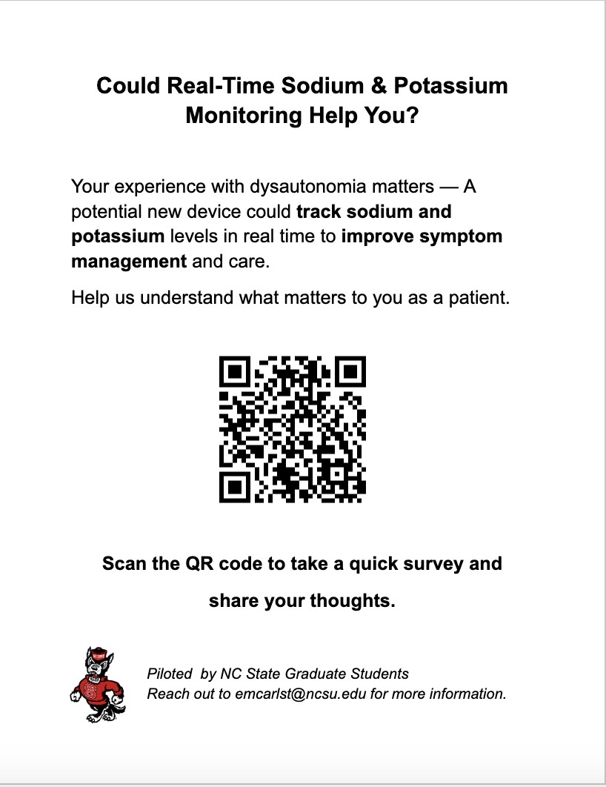
VOC Survey #1: User-Targeted Survey
Notes:
elise

Slide 23
VOC Survey #1: User-Targeted Survey
Challenges:
Difficult to receive responses from support group administrators
High level regulation and confidentiality practices
Lack of places to post flyers
Category | Contacted | Heard From
Kidney Disease Groups | 22 | 3
Dysautonomia Groups | 10 | 2
Social Media | Reddit, Linkedin | ?
We have a total of 16 survey responses.
Notes:
elise

Slide 24
VOC Survey #2: Provider-Targeted Survey
Research Questions:
What are the biggest challenges and limitations in current Na+/K monitoring practices in inpatient and critical care settings?
What are the key factors influencing the adoption of real-time Na+/K monitoring technology?
How could real-time electrolyte monitoring improve patient outcomes, clinical decision-making, and health economics?
This survey is designed to be direct, highly informative, and targeted toward professionals.
Notes:
elise

Slide 25
VOC Survey #2 - Provider Targeted Survey
Challenges
Primary focus: Mix of in-patient and out-patient KOLs
Doctors/nurses/clinical staff are really busy
Again, difficult to distribute survey and dependent on spread through KOLs
Thought Process:
→ Providers would determine adoption of technology in practice
→ Providers would use the technology/determine feasibility
→ Providers would tell patients
→ Patients could buy the technology
Notes:
https://ncsu.qualtrics.com/jfe/form/SV_4Hgigiyz5UaFwN0

Slide 26
Business Model Canvas
Notes:
Charlie i finish it up

Slide 27
Hurdles
Approaches
#1 - Confidentiality and Regulatory Approval
IRB approval, FDA clearance due to the sensitive nature of medical data
#2 - Adoption Costs
High costs could limit adoption, especially in niche markets.
#3 - Workflow Integration
Must be: accurate, integrated into workflow, comparable to traditional blood tests
#4 - Biocompatibility Risks
Copper material could cause inflammation, tissue damage, or adverse reactions in the body
#1 - Demonstrate Reliability and Trust
Work closely with regulatory bodies to ensure compliance and expedite approval
#2 - Cost Savings > Initial Investment
Demonstrate clear cost savings through reduced ICU stays, improved clinical outcomes, etc.
#3 - Collaboration and Interoperability
Validation against standard venous blood tests, define variability limits, collaborate with current manufacturers
#4 - Establish Safety in vivo through R&D
Non-toxic materials or applying protective coatings can prevent harmful reactions and improve safety in medical devices

Slide 28
Since last time…
In-Patient Application
Expanded Market to Include Liver Cancer/Cirrhosis
Spoke to PhD about ISF sensor
Learned About Health Economics
Expanded application areas to better serve in-patient settings, particularly for severe hyponatremia and hyperkalemia management.
Broadening market to include patients with liver diseases who are also at high risk for electrolyte imbalances.
Current microneedle sensor technology does real-time monitoring of sodium/potassium through ISF and there are ongoing improvements for biocompatibility.
$$$ = King: Reducing ICU visits is crucial for better patient outcomes and reducing hospital costs →a key focus for the device adoption

Slide 29
KEY PARTNERS | KEY ACTIVITIES | VALUE PROPOSITIONS |  | CUSTOMER RELATIONSHIPS | CUSTOMER SEGMENTS
CGM Manufacturers: Dexcom, Abbott ICU/Inpatient Care: Comparable to gold standard metabolic blood panel Dialysis: Medtronic, Fresenius, Baxter Regulatory agencies: FDA, EMA, IRB | Developing a technical team Performing early R&D IP & Licensing with collaborators Clinical validation and regulatory input Commercial production, marketing, distribution | Optimize Care: provide fast, accurate data for inpatient care settings Outpatient Autonomy: timely results to adjust prescriptions, monitor progress, understand alterations Health Economics: lower costs, improve patient care management, disease tracking Reduce health issues and mortality rates from improper Na/K management |  | Inpatient care training/integration Data integration support Licensing/Exclusivity | Healthcare providers (nephrologists, nurses) Diagnostics (monitoring) Healthcare systems and payers (hospitals, insurance) Data Management (McKesson, IQVIA, Oracle)
 | KEY RESOURCES |  |  | CHANNELS
 | Hardware/software developers Clinical, IP, Licensing support Manufacturing & Capital Partners |  |  | Healthcare providers & networks Inpatient Care Direct-to-consumer? Payer partnerships Clinical studies
COST STRUCTURE |  |  | REVENUE STREAMS
 |  |  | Fixed Pricing Model → DTC sales, Provider prescription/insurance Licensing with CGM manufacturers and interoperability partners
Notes:
Change font

Slide 30
Final Thoughts
AccuNaK
Desirability Does anyone want this? | Feasibility Is this technologically possible? | Viability Can the business be sustained?
⏶ | = | ⏶
High ⏶ | high consumer demand, significant application potential, sector interest by industry partners, leverage existing technology
Medium = | good consumer base, application potential, sector interest by industry partners, may need further R&D
Low ⏷ | low consumer interest, niche application, significant R&D, poor revenue potential

Slide 31
Resources
Napkin AI, ChatGPT
https://www.grandviewresearch.com/industry-analysis/renal-failure-treatment-market-report#:~:text=Renal%20Failure%20Treatment%20Market%20Trends,8.3%25%20from%202024%20to%202030.
https://www.gminsights.com/industry-analysis/dialysis-market
https://www.fortunebusinessinsights.com/dialysis-market-102367
https://www.imarcgroup.com/dialysis-market
https://www.researchnester.com/reports/dialysis-market/4643
https://www.grandviewresearch.com/industry-analysis/us-hemodialysis-peritoneal-dialysis-market-report
https://www.grandviewresearch.com/industry-analysis/us-continuous-glucose-monitoring-devices-market-report
https://market.us/report/electrolyte-markers-market/
https://www.futuremarketinsights.com/reports/bioimpedance-analyzer-market
https://pmc.ncbi.nlm.nih.gov/articles/PMC9025702/
https://kdigo.org/wp-content/uploads/2024/03/KDIGO-2024-CKD-Guideline.pdf
https://nccd.cdc.gov/ckd/
https://www.nature.com/articles/s43246-024-00606-0
https://www.frontiersin.org/journals/nephrology/articles/10.3389/fneph.2023.1148565/full
https://revistanefrologia.com/en-remote-patient-monitoring-management-in-articulo-S2013251424001937
https://optimize.health/blog/benefits-of-rpm-for-nephrology/
https://www.sciencedirect.com/science/article/pii/S0165993620303770
https://www.uspto.gov/patents/search
https://www.goodrx.com/health-topic/kidneys/dialysis-cost
https://www.goodrx.com/health-topic/diagnostics/how-much-is-blood-work-without-insurance
https://medicine.duke.edu/divisions/nephrology/primary-faculty
https://www.med.unc.edu/medicine/nephrology-hypertension/training/adult-nephrology-training-program/faculty/
https://www.globenewswire.com/news-release/2025/03/06/3038015/0/en/Liver-Cirrhosis-Treatment-Market-Research-2023-2024-2024-Asia-Pacific-is-Predicted-to-Grow-at-the-Fastest-Rate-Owing-to-the-Rising-Prevalence-of-Hepatitis-B.html#:~:text=The%20global%20liver%20cirrhosis%20treatment,the%20forecast%20period%202024%2D2034.
https://finance.yahoo.com/news/alcoholic-hepatitis-treatment-market-reach-181000957.html?guccounter=1&guce_referrer=aHR0cHM6Ly93d3cuZ29vZ2xlLmNvbS8&guce_referrer_sig=AQAAALlBxGdhAS6dPNS7jM80O_jJuSBQAugmMR3YC-X2OiJazRjcWbOlphmmGduMtzwfp0ffQWoOlZt61wLyp26KhuC9OEA0xxq2k8bHjhxeSwWh1sbylYTMX_x8D2ydzDZlKVLL7ll4JX2-TP_v3IgkbM-5eMIFk-lMLbn0aXPrzFZi
https://www.hcplive.com/view/alcohol-associated-hepatitis-hospitalizations-increased-covid-19?utm_source=chatgpt.com
https://www.gastrores.org/index.php/Gastrores/article/view/1506/1484
https://pubmed.ncbi.nlm.nih.gov/30333543/#:~:text=Mean%20age%20at%20hospitalization%20increased,means%20to%20have%20decompensated%20CLD.
https://journals.sagepub.com/doi/10.1177/1751143720978849?icid=int.sj-abstract.similar-articles.8#:~:text=A%20recent%20analysis%20of%20Intensive,9%E2%80%9311
https://www.marketresearchfuture.com/reports/dysautonomia-market-27222#:~:text=Global%20Dysautonomia%20Market%20Overview,(USD%20Billion)%20by%202032.
https://www.marketresearchfuture.com/reports/hyponatremia-treatment-market-37946?utm_source=chatgpt.com
https://pmc.ncbi.nlm.nih.gov/articles/PMC8103825/
https://www.dysautonomiainternational.org/pdf/salt.pdf
https://thedysautonomiaproject.org/salt-and-dysautonomia/
https://www.dysautonomiasupport.org/?gad_source=1&gclid=CjwKCAiA2cu9BhBhEiwAft6IxGRvGPmw8VoJF74NQJsNwvIs3gCSZ_k7bknw4EduVluHfeNihB4WwBoCA40QAvD_BwE
https://www.dysautonomiainternational.org/page.php?ID=36
https://kermitsense.eu/
https://nixbiosensors.com/
https://www.dexcom.com/
https://www.freestyle.abbott/us-en/home.html?srsltid=AfmBOoqqg1egT-3Ka16zU22gmI7dAHGsqiG10DvkHWz4jRC3cmM5xlIJ
Li, H., Wu, G., Weng, Z., Sun, H., Nistala, R., & Zhang, Y. (2021). Microneedle-Based Potentiometric Sensing System for Continuous Monitoring of Multiple Electrolytes in Skin Interstitial Fluids. ACS Sensors, 6(6), 2181–2190. https://doi.org/10.1021/acssensors.0c02330
Juan José García-Guzmán, Clara Pérez-Ràfols, Maria Cuartero, Gaston A. Crespo,Microneedle based electrochemical (Bio)Sensing: Towards decentralized and continuous health status monitoring, TrAC Trends in Analytical Chemistry, Volume 135, 2021, 116148, ISSN 0165-9936, https://doi.org/10.1016/j.trac.2020.116148.

Slide 32
Thanks
Do you have any questions?
Please keep this slide for attribution

Slide 33
Icon pack

